Slide 1





Prepared By:
RUPESH RATHOD.
Submitted To:

Slide 2

Introduction
What is ORM?
About Installation, Connection & Testing
Migration And Seeder
Models & Relationships
Getter, Setters & Virtual
Hooks
Eager Loading
Basic Querying
Q&A Session

Slide 3

What is Sequelizer?
Sequelizer is the promise based URL in the node Js.
Sequelizer is easy to learn & has dozen of cool features like synchronization,association,validations etc
Support Node V6 and above to use ES6 features.
It also has support for MYSQL, PostgreSQL, MariaDB, SQLite and MSSQL.

Slide 4

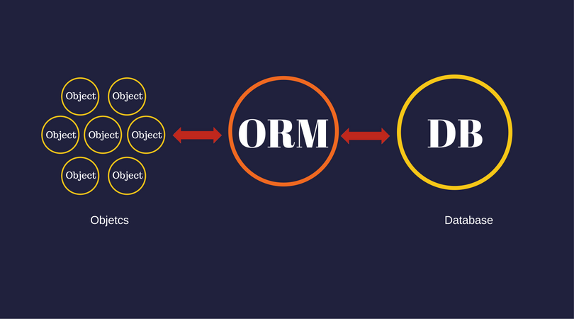
ORM is the object relational mapping.
It’s the process of mapping between objects
& relational data base system
An ORM is act like an interface between two system
ORM provide the advantages for developers from basic one like saving time & effort and rather focusing on business logic.

Slide 5


Installation :
Sequelizer is available via NPM
npm install - - save sequelize
You also have to install manually the driver for the database of you choice:
# One of the following
$ npm install - - save pg pg-hstore #Postgres
$ npm install - - save mysql2 #MYSQL
$ npm install - - save mariadb
$ npm install - - save sqlite3
$ npm install - - save tediuos #Microsoft SQL Server
CLI : npm install -g sequelize-cli

Slide 6
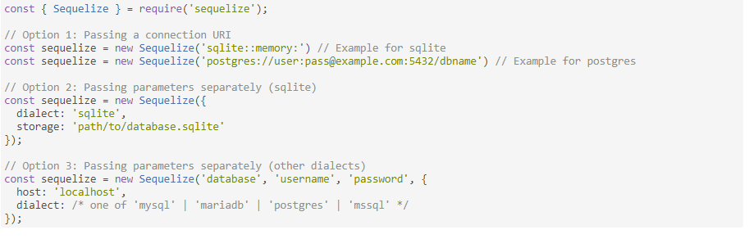
Database Connection:
To connect to the database, you must create a Sequelize instance. This can be done by either passing the connection parameters separately to the Sequelize constructor or by passing a single connection URL:

Slide 7
Testing the connection
You can use the .authenticate() function to test if the connection is OK:
try {
await sequelize.authenticate();
console.log('Connection has been established successfully.');
} catch (error) {
console.error('Unable to connect to the database:', error);
}
Closing the connection
Sequelize will keep the connection open by default, and use the same connection for all queries. If you need to close the connection,
call sequelize.close() (which is asynchronous and returns a Promise).

Slide 8

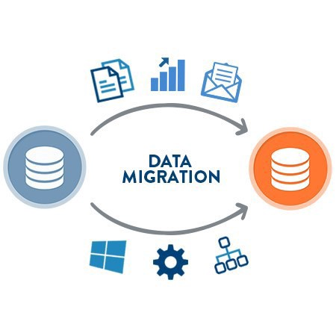
Migration
For Add :
npx sequelize-cli migration:generate --name Jobs migration-skeleton
For Edit:
npx sequelize-cli migration:create –name modify_users_add_new_fields
Migration Command :
sequelize db:migrate

Slide 9
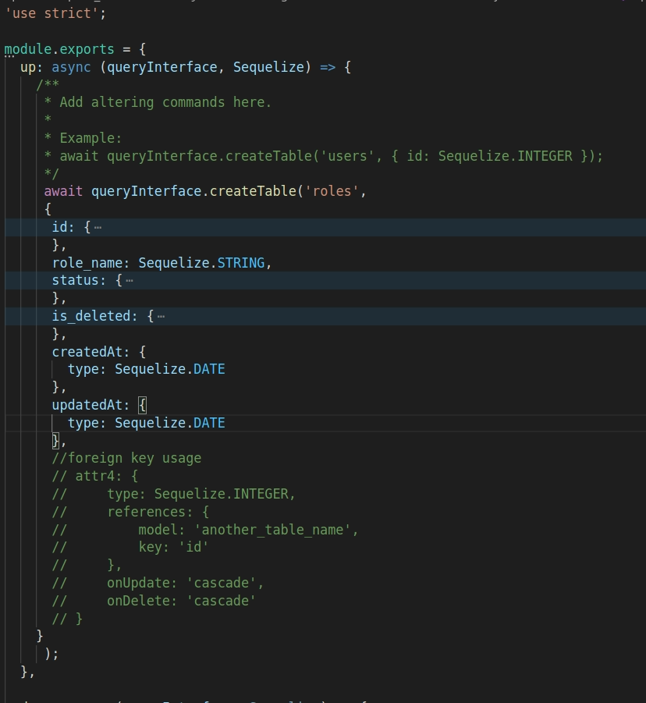
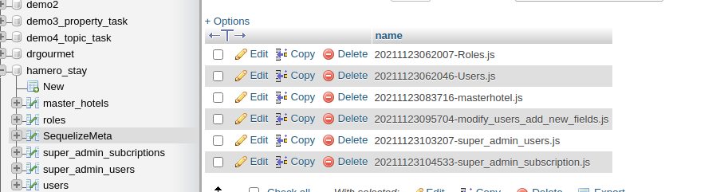

Slide 10

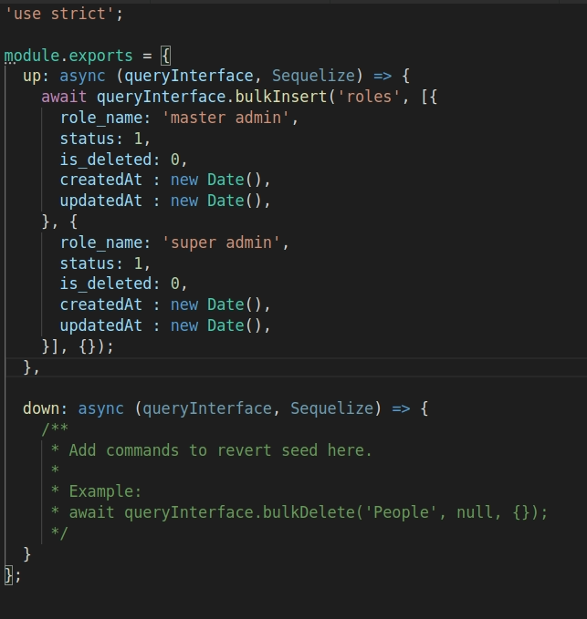
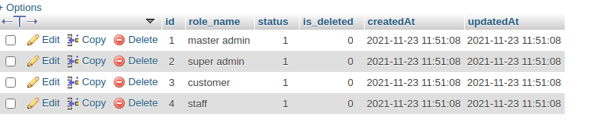
Seeder
For create the seeder directory & seeder file :
sequelize seed:create --name my-seed-file
For run the seeder
sequelize db:seed:all

Slide 12

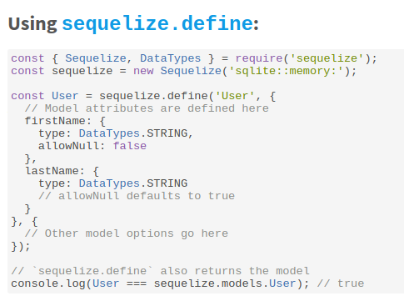
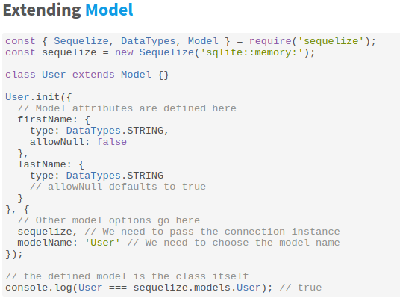
Models can be defined in two equivalent ways in Sequelize:
Calling sequelize.define(modelName, attributes, options)
Extending Model and calling init(attributes, options)
After a model is defined, it is available within sequelize.models by its model name.
command for create the model
sequelize model:generate --name Company --attributes name:STRING

Slide 13
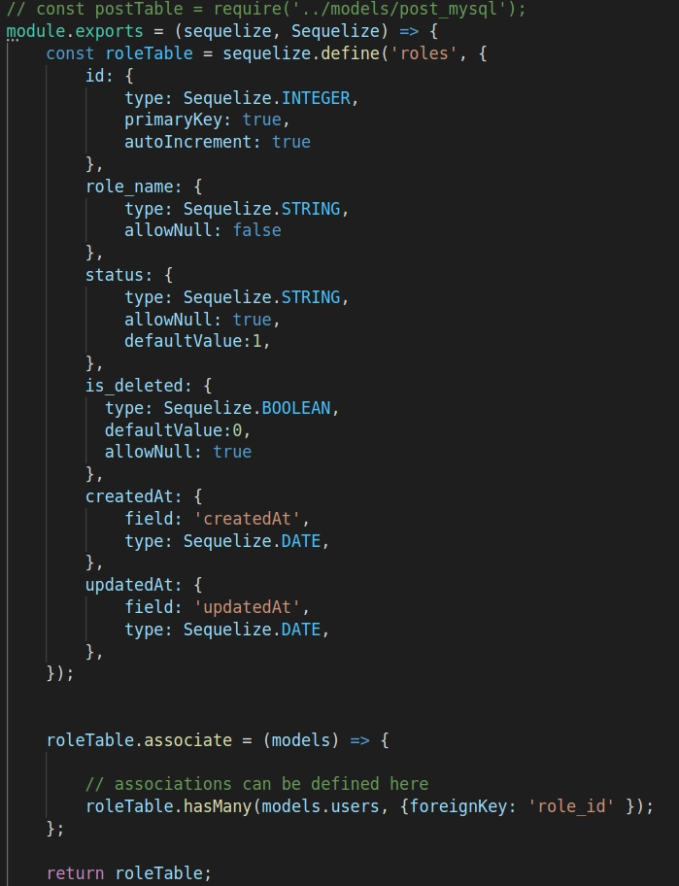

Slide 14
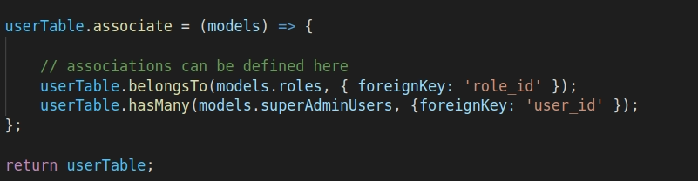
Relation in Sequelizer
To create a One-To-One relationship, the hasOne and belongsTo associations are used together;
To create a One-To-Many relationship, the hasMany and belongsTo associations are used together;
To create a Many-To-Many relationship, two belongsToMany calls are used together.

Slide 15

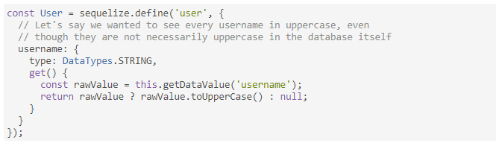
Sequelize allows you to define custom getters and setters for the attributes of your models.
Sequelize also allows you to specify the so-called virtual attributes, which are attributes on the Sequelize Model that doesn't really exist in the underlying SQL table, but instead are populated automatically by Sequelize. They are very useful for simplifying code, for example
Getter
const user = User.build({ username: 'SuperUser123' });
console.log(user.username); // 'SUPERUSER123' console.log(user.getDataValue('username')); // 'SuperUser123'

Slide 16
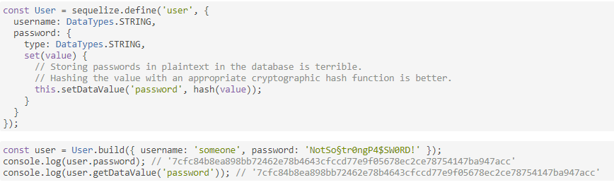
Setter
A setter is a set() function defined for one column in the model definition. It receives the value being set:

Slide 17
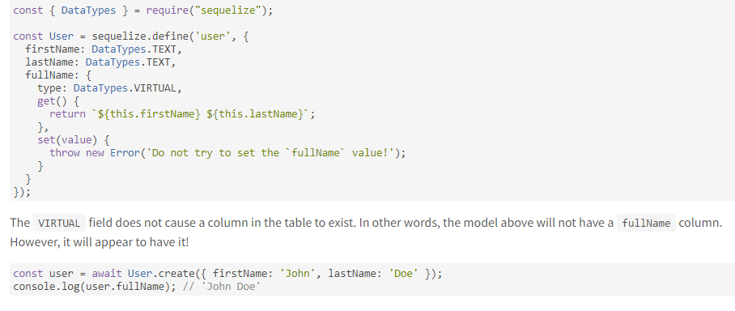
Virtual
Virtual fields are fields that Sequelize populates under the hood, but in reality they don't even exist in the database.
For example, let's say we have the firstName and lastName attributes for a User.
It would be nice to have a simple way to obtain the full name directly! We can combine the idea of getters with the special data type Sequelize provides for this kind of situation: DataTypes.VIRTUAL:

Slide 18

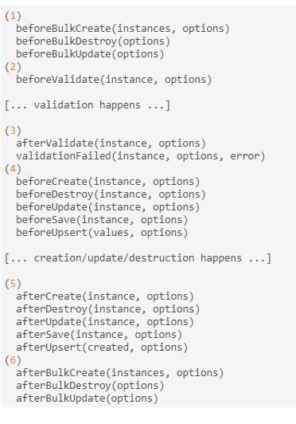

What is the Hooks?
Hooks (also known as lifecycle events), are functions which are called before and after calls in sequelize are executed

Slide 19
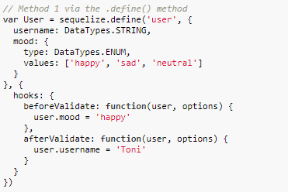
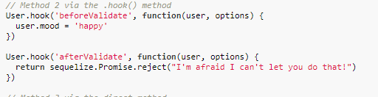
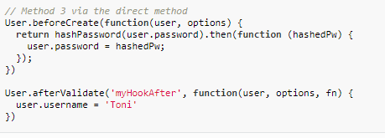
There are currently three ways to programmatically add hooks:

Slide 20

Eager Loading is the act of querying data of several models at once (one 'main' model and one or more associated models)
When this is done, the associated models will be added by Sequelize in appropriately named, automatically created field(s) in the returned objects.
In Sequelize, eager loading is mainly done by using the include option on a model finder query (such as findOne, findAll, etc)

Slide 21
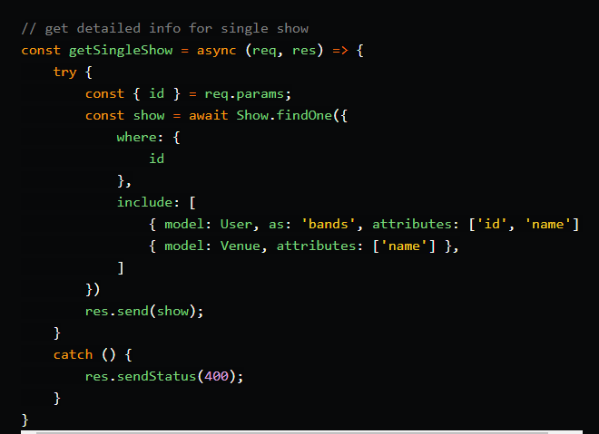
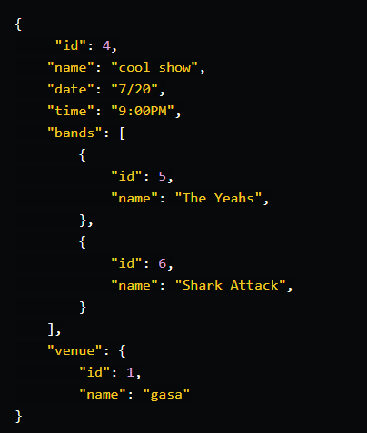
Query
Output

Slide 22
Basic Queries
Raw Query
sequelize.query("SELECT * FROM `users`", { type: sequelize.QueryTypes.SELECT})
.then(users => {
// We don't need spread here, since only the results will be returned for select queries
})
Update Query
await User.update({ lastName: "Doe" }, { where: {lastName: null}});
Select Query
const users = await User.findAll();
Create Query
const jane = await User.create({ firstName: "Jane", lastName: "Doe" });
console.log("Jane's auto-generated ID:", jane.id);
Where Clause Query
Post.findAll({
where: {
authorId: 2
}
});
Delete Query
await User.destroy({where: {firstName: "Jane"}});

Slide 23

https://sequelize.org/master/manual/eager-loading.html
https://sequelize.org/master/manual/model-basics.html
https://medium.com/@ipenywis/learn-sequelize-orm-on-node-js-with-mysql-from-scratch-in-one-video-61a483ecfa45
https://sequelize.org/v3/docs/hooks/

Slide 24


